Slide 1
Secure Web Applications Development
CI Sessions & Cookies

Slide 2
What is Session Control?
You might have heard people say that “HTTP is a stateless protocol”.
This means that the protocol has no built-in way of maintaining state between two transactions. When a user requests one page, followed by another, HTTP does not provide a way for you to tell that both requests came from the same user.
The idea of session control is to be able to track a user during a single session on a website.
If you can do this, you can easily support logging in a user and showing content according to his/her authorization level or personal preferences.
You can also track their activity.

Slide 3
Understanding the basics
Sessions in PHP are driven by a unique session ID, a cryptographically random number.
This session ID is generated by PHP/CodeIgniter and stored on the client side for the lifetime of a session.
The session id can be passed along through URL’s.
Leads to very ugly URL’s.
Search engines may have problems indexing your site with these type of URL’s.
It can be a security risk.
More often than not, its saved in a cookie and passed to the server when a request is made.

Slide 4
Understanding the basics
The session ID acts as a key that allows you to register particular variables as so-called session variables.
The contents of these variables are stored on the server.
The session ID is the only information visible on the client side.
Cookies are a different solution to the problem of preserving state across a number of transactions while still having a “clean-looking” URL.
Cookies have some associated problems. Some browsers do not accepts cookies and some users have disabled cookies in their browsers.

Slide 5
Sessions in CodeIgniter
CodeIgniters Session class stores session information for each user as serialized (and optionally encrypted) data in a cookie.
The Session class does not utilize native PHP sessions.
It generates its own session data, offering more flexibility for developers.
It can also store the session data in a database table for added security, as this permits the session ID in the user's cookie to be matched against the stored session ID.
By default only the cookie is saved.
If you choose to use the database option you'll need to create a table in your database to store this information.

Slide 6
Sessions in CodeIgniter
When using sessions with CodeIgniter, you must set an encryption key in your config file which is used as an aid to prevent session data manipulation.
The more “random” the key, the more secure your site it is.

Slide 7
Sessions in CodeIgniter
If you neglect to set the encryption key, CodeIgniter will throw an error when you attempt to use sessions.
Once you add your encryption key, you just need to save it => a restart of your server is not required.

Slide 8
Initialising a CodeIgniter Session
Sessions will typically run globally with each page load, so the session class must either be initialised in your controller constructors, or it can be auto-loaded by the system.
For the most part the session class will run unattended in the background, so simply initializing the class will cause it to read, create, and update sessions.
To initialize the Session class manually in your controller constructor, use the following:
$this->load->library('session');
Once loaded, the Sessions library object will be available using: $this->session

Slide 9
How do Sessions Work
When a page is loaded, the session class will check to see if valid session data exists in the user's session cookie. If sessions data does not exist (or if it has expired) a new session will be created and saved in the cookie.
If a session does exist, its information will be updated and the cookie will be updated.
With each update, the session_id will be regenerated.
It's important for you to understand that once initialized, the Session class runs automatically.
There is nothing you need to do to cause the above behaviour to happen.
You can, as you'll see, work with session data or even add your own data to a user's session, but the process of reading, writing, and updating a session is automatic.

Slide 10
What is Session Data
A session, as far as CodeIgniter is concerned, is simply an array containing the following information:
The user's unique Session ID (this is a statistically random string with very strong entropy, hashed with MD5 for portability, and regenerated (by default) every five minutes)
The user's IP Address
The user's User Agent data (the first 120 characters of the browser data string)
The "last activity" time stamp.

Slide 11
What is Session Data
The prototype for this array is as follows:
[array] (
'session_id' => random hash,
'ip_address' => 'string - user IP address',
'user_agent' => 'string - user agent data',
(NOTE - unused by CI sessions)
'last_activity' => timestamp )

Slide 12
Reading Session Data
Any piece of information from the session array is available using the following mechanism:
$name = $_SESSION['name']; OR
$name = $this->session->name OR
$name = $this->session->userdata('name');
The userdata method returns NULL if the item you are trying to access does not exist.
If you want to retrieve all of the existing userdata
$_SESSION OR
$this->session->userdata();

Slide 13
Adding Custom Session Data
You can also add your own data to a session and it will be stored in the user's cookie.
Why would you want to do this? Here's one example:
Let's say a particular user logs into your site. Once authenticated, you could add their username and email address to the session cookie, making that data globally available to you without having to run a database query when you need it.
To add your data to the session array involves passing an array containing your new data to this function:
$this->session->set_userdata($array);
You can also add items individually like this:
$this->session->set_userdata(‘aName', ‘aValue’);

Slide 14
Checking on Session Data
If you want to verify that a session value exists, simply check with isset():
// returns FALSE if the 'some_name' item doesn't exist or is NULL,
// TRUE otherwise:
isset($_SESSION['some_name'])
Or you can call has_userdata():
$this->session->has_userdata('some_name');

Slide 15
Removing Session Data
Unsetting a value in $_SESSION can be done through unset():
unset($_SESSION['some_name']);
Or for multiple values:
unset(
$_SESSION['some_name'],
$_SESSION['another_name']
);
Also, just as set_userdata() can be used to add information to a session, unset_userdata() can be used to remove it, by passing the session key. For example, if you wanted to remove ‘some_name’ from your session data array:
$this->session->unset_userdata('some_name');
This method also accepts an array of item keys to unset:
$array_items = array('username', 'email');
$this->session->unset_userdata($array_items);

Slide 16
Example 1 – Adding Data to a Session
The sample code for this example is on Moodle – CIgetAuthor2018SessionA
Allow the user to search for an author in the Books database by specifying an authors ID as the search criteria.
Our example will then retrieve the record that matches the ID and then put the following into session:
The authors ID.
The authors first name.
The authors last name.
We will then provide a link that the user can follow that will simply display all the data within the session.

Slide 17
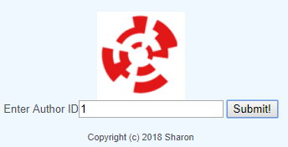
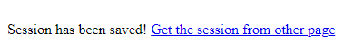
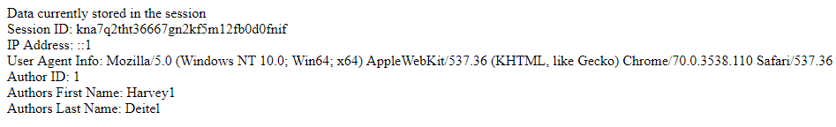
Example 1 – Adding Data to a Session
Flow of the example:

Slide 18
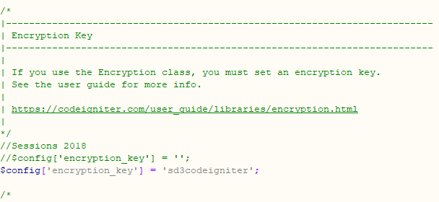
Example 1 – Adding Data to a Session
Relevant Code – config.php

Slide 19
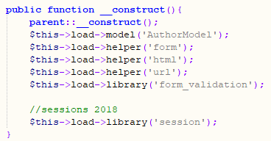
Example 1 – Adding Data to a Session
Relevant Code – AuthorController - Constructor

Slide 20
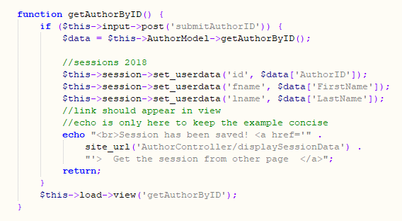
Example 1 – Adding Data to a Session
Relevant Code – AuthorController – getAuthorByID function

Slide 21
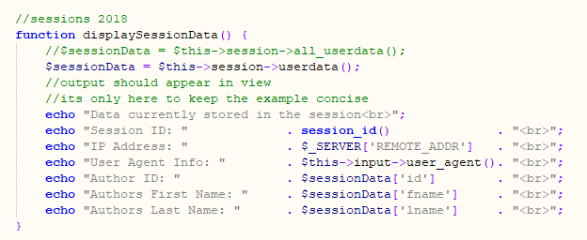
Example 1 – Adding Data to a Session
Relevant Code – AuthorController – displaySessionData function

Slide 22
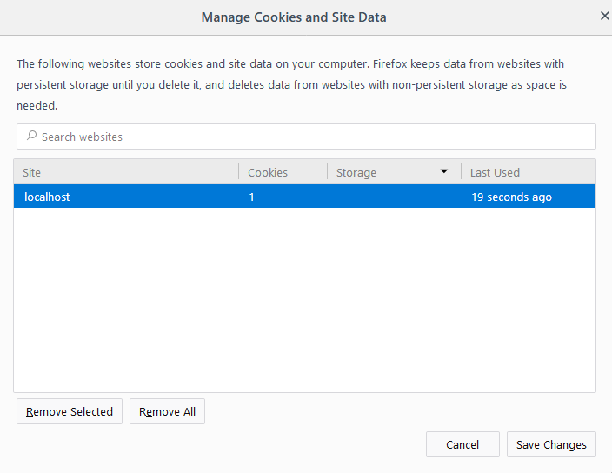
Example 1 – Adding Data to a Session
A quick look at the cookies stored in my browser shows the one my application has created.

Slide 23
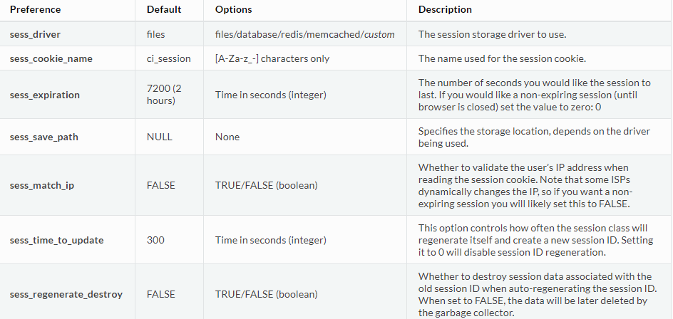
Setting Configuration Options for Sessions
In your config file, you may want to set the following configuration options.

Slide 24
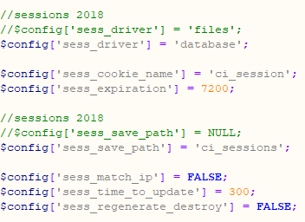
Setting Configuration Options for Sessions
To store session data in a database table, see the following changes

Slide 25
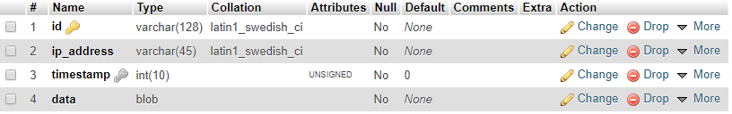
Creating a table in your DB to manage sessions
CREATE TABLE IF NOT EXISTS `ci_sessions` (
`id` varchar(128) NOT NULL,
`ip_address` varchar(45) NOT NULL,
`timestamp` int(10) unsigned DEFAULT 0 NOT NULL,
`data` blob NOT NULL,
KEY `ci_sessions_timestamp` (`timestamp`)
);
Providing you make the necessary changes to the config file, CodeIgniter will automatically save all session data to the sessions table in your DB.

Slide 26
Creating a table in your DB to manage sessions
CREATE TABLE IF NOT EXISTS `ci_sessions` (
`id` varchar(128) NOT NULL,
`ip_address` varchar(45) NOT NULL,
`timestamp` int(10) unsigned DEFAULT 0 NOT NULL,
`data` blob NOT NULL,
KEY `ci_sessions_timestamp` (`timestamp`)
);
Providing you make the necessary changes to the config file, CodeIgniter will automatically save all session data to the sessions table in your DB.

Slide 27
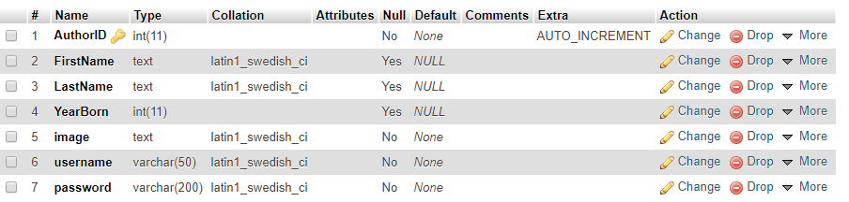
Amending my authors table
In the upcoming example I am going to log authors (from the books DB) in and out of my site. Only authenticated authors will get to see the “secret content”. Therefore the authors table will need to be altered.
I’m going to add two new fields to what we had before. The authors user name & the authors password (which I will encrypt with MD5).

Slide 28
Example 2 – The Problem
The sample code for this example is on Moodle – CIgetAuthor2018SessionB
Using the newly updated authors table, present users with a login form.
If the user enters valid logon credentials then present them with the secret content/restricted area.
If we are dealing with a valid user, we will put their username and their author ID into session.
This will allow us to check at any point/on any page if the user has previously (successfully) logged in.
If the user enters invalid logon credentials then present them (again) with the login form and an error message.
Both fields on the logon form are required input.
The user (once logged in) will be afforded the opportunity to log out (at which point we will destroy the session and return them to the login form).

Slide 29
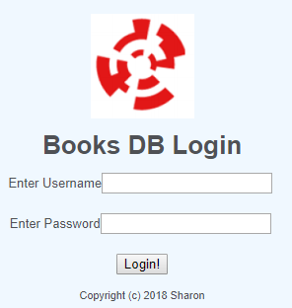
Example 2 – The Problem
The login form will look like this

Slide 30
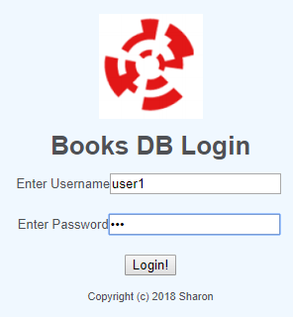
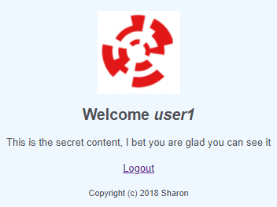
Example 2 – Sample Run – Valid User

Slide 31
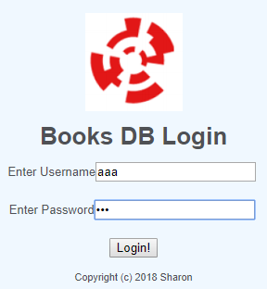
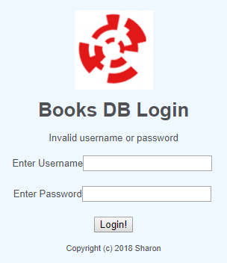
Example 2 – Sample Run – Invalid User

Slide 32
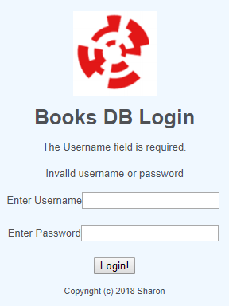
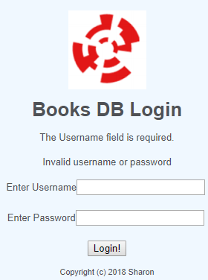
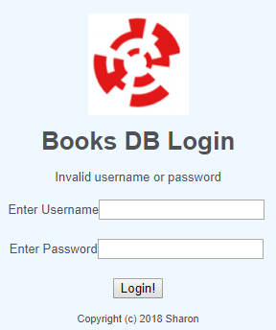
Example 2 – Sample Run – Missing Input
User submits form with no input
User submits form with no username provided
User submits form with no password provided

Slide 33
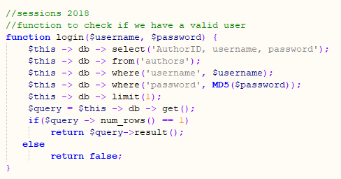
Example 2 – The Model

Slide 34
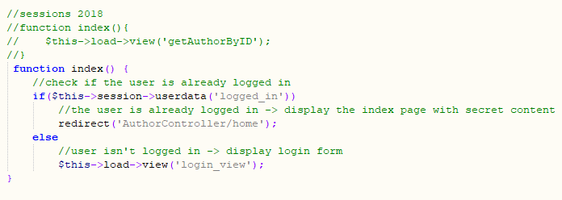
Example 2 – The Controller – New Functions

Slide 35
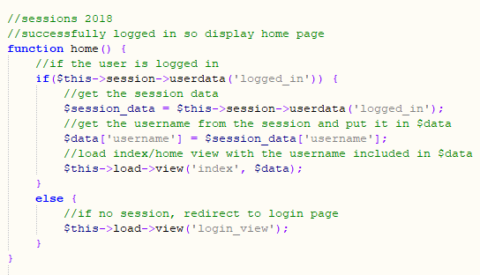
Example 2 – The Controller – New Functions

Slide 36
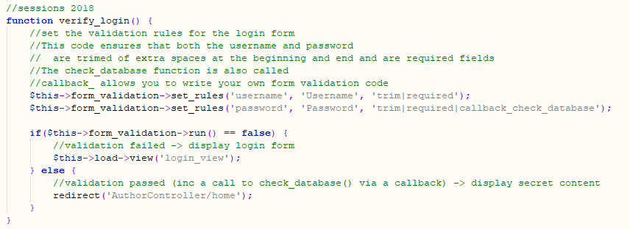
Example 2 – The Controller – New Functions

Slide 37
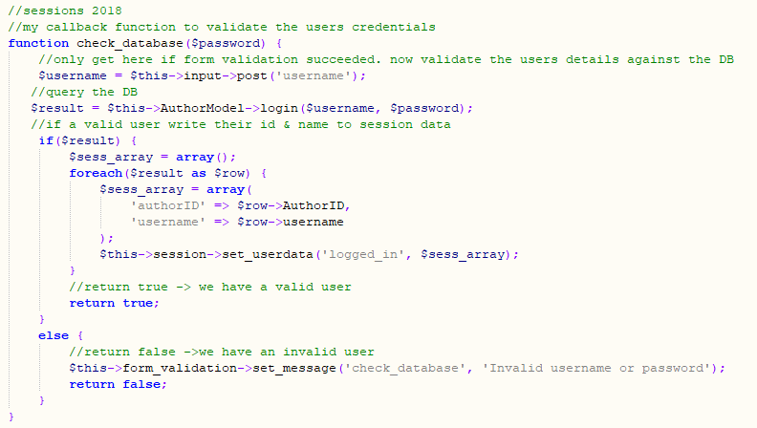
Example 2 – The Controller – New Functions

Slide 38
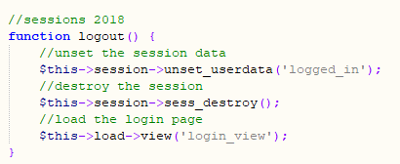
Example 2 – The Controller – New Functions

Slide 39
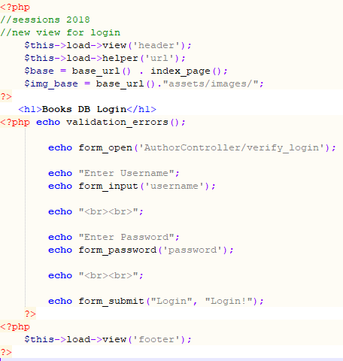
Example 2 – The Login View

Slide 40
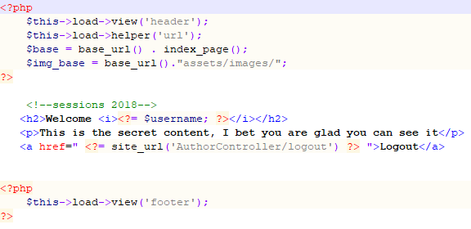
Example 2 – The Index View (with secret)

Slide 41
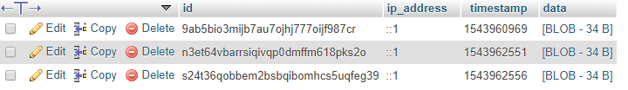
Example 2 – Session Table in DB
All session details are logged in the sessions table of my DB.

